Slide 1
Graphics And PHP

Slide 2
The Web is more than just text.
Images appear in the form of logos, buttons, photographs, charts, advertisements, and icons.
Many of these images are static and never change, built with tools such as Photoshop.
Some are dynamically created—graphs of stock performance.
Graphics in PHP typically involve creating, manipulating, and rendering images and visual content.
PHP supports graphics creation with the built-in GD (Graphics Draw) extension
GD allows you to create and manipulate images, draw shapes, add text, and perform various image processing tasks.
GD supports image formats in jpeg, png, gif, and wbmp.

Slide 3
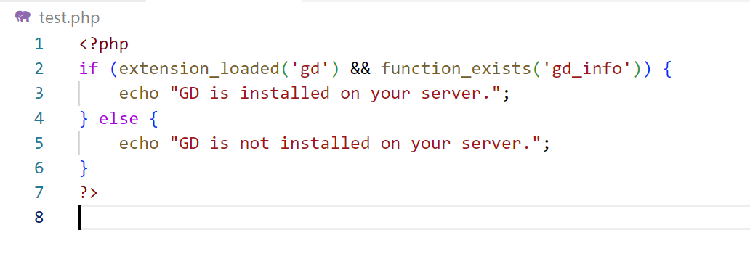
How to check if GD is installed or not

Slide 4


If GD is not installed, you may need to enable it in your PHP configuration.
Open files C:\xampp\php

Slide 5
Open PHP Config file
Search For GD
Enable GD extension by removing the semicolon from the front
Restart your Xampp Server and now your GD library is installed on the system.

Slide 6
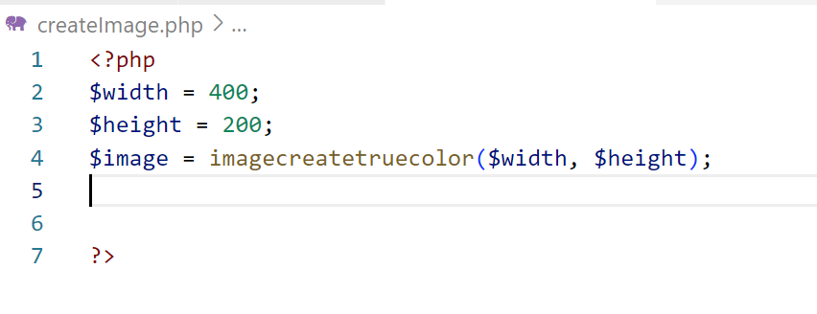
Creating an Image:
You can create a new image using the imagecreate() or imagecreatetruecolor function, which creates a true-color image resource.
imagecreatetruecolor() returns an image object representing a black image of the specified size.

Slide 7

Drawing on the Image:
The imagecolorallocate() function can be used to create the link, and it requires four arguments

Slide 8
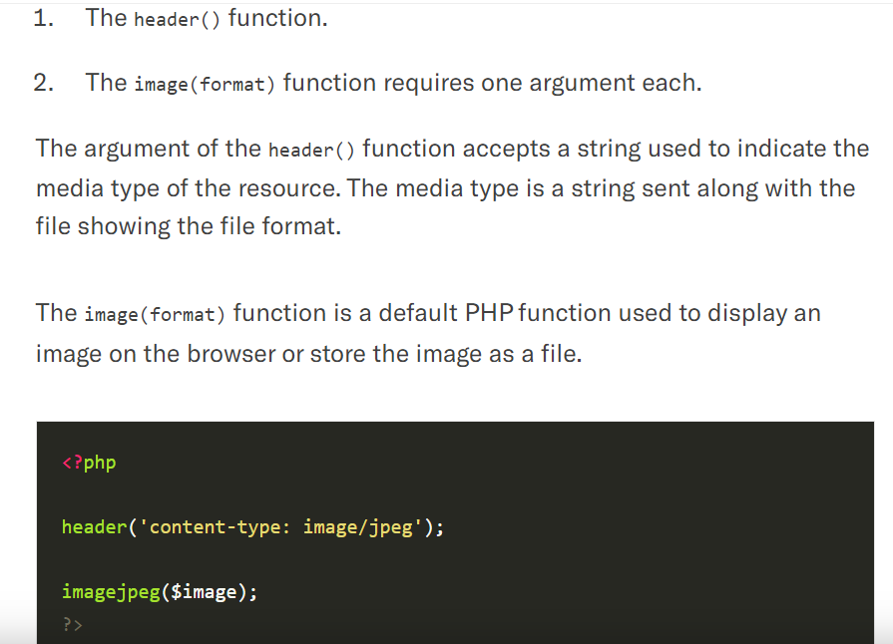

Slide 9
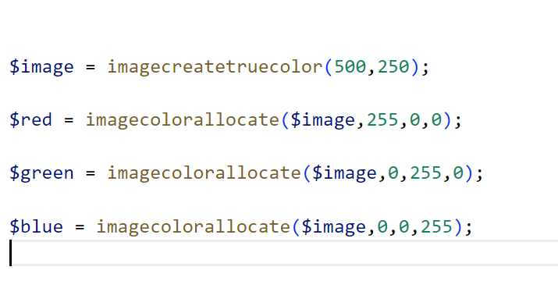
Working example

Slide 10
Basic Drawing Functions
imagesetpixel(image, x, y, color)
Imagesetpixel( ) sets the color of a specified pixel.
Functions for drawing lines
imageline(image, start_x, start_ y, end_x, end_ y, color);
imagedashedline(image, start_x, start_ y, end_x, end_ y, color);
Functions for drawing rectangles
imagerectangle(image, tlx, tly, brx, bry, color);
imagefilledrectangle(image, tlx, tly, brx, bry, color);
Functions for drawing polygons
imagepolygon(image, points, number, color);
imagefilledpolygon(image, points, number, color);

Slide 11
Basic Drawing Functions
<?php
//how to create our first image
$image = imagecreate(500,250);
//Allocate colors to the image
$red = imagecolorallocate($image,255,0,0);
$green = imagecolorallocate($image,0,255,0);
$blue = imagecolorallocate($image,0,0,255);
Imagefill($image,0,0,$blue);
//display the image
header('content-type: image/jpeg');
imagejpeg($image);
?>

Slide 12

Basic Drawing Functions

Slide 13
Rectangle
<?php
$image = imagecreate(200, 200);
$bgcolor = imagecolorallocate($image, 0, 0, 255);
$fgcolor = imagecolorallocate($image, 255, 0, 0);
imagefilledrectangle($image, 100, 50, 150, 150, $fgcolor);
header("Content-Type: image/jpeg");
imagejpeg($image);
?>

Slide 14

OUTPUT

Slide 15
Imagerotate
<?php
// File and rotation
$filename = 'test.jpg';
$degrees = 45;
// Content type
header('Content-type: image/jpeg');
// Load
$source = imagecreatefromjpeg($filename);
// Rotate
$rotate = imagerotate($source, $degrees, 0);
// Output
imagejpeg($rotate);
// Free the memory
imagedestroy($source);
imagedestroy($rotate);
?>

Slide 16
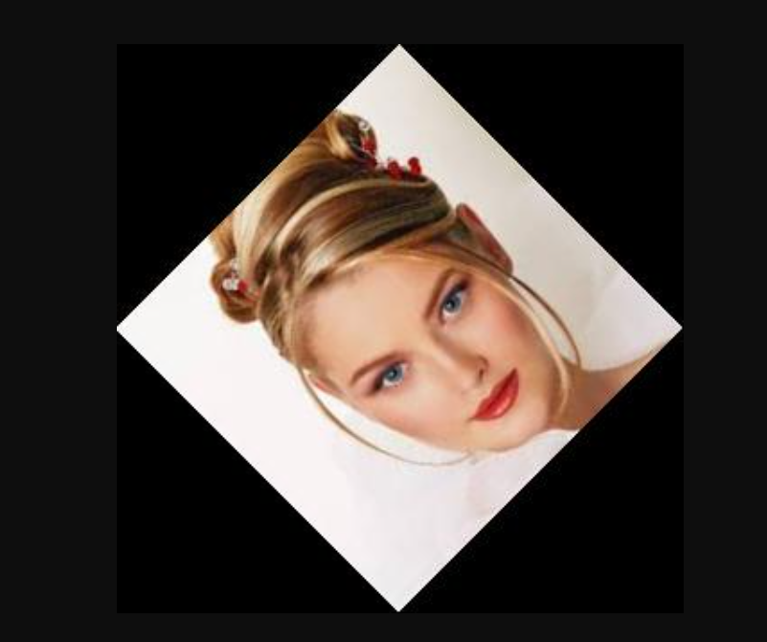
OUTPUT

Slide 17
IMAGE CREATE FUNCTIONS
Image Creation and Initialization
imagecreatetruecolor(): Create a new true-color image.
imagecreatefromjpeg(), imagecreatefrompng(), imagecreatefromgif(): Create an image resource from existing image files (JPEG, PNG, GIF).
imagecreatefromstring(): Create an image resource from a string.

Slide 18
Drawing Basic Shapes
imageline(): Draw a line.
imagerectangle(): Draw a rectangle.
imagefilledrectangle(): Draw and fill a rectangle.
imageellipse(): Draw an ellipse.
imagefilledellipse(): Draw and fill an ellipse.
imagearc(): Draw an arc.

Slide 19
Drawing Complex Shapes:
imagepolygon(): Draw a polygon.
imagefilledpolygon(): Draw and fill a polygon.
imagecreatepolygon(): Create a new polygon.
Drawing Text:
imagettftext(): Draw TrueType text on an image.
imagestring(): Draw a string horizontally.
imagestringup(): Draw a string vertically.

Slide 20
Image Manipulation:
imagecopyresized(): Copy and resize part of an image.
imagecopyresampled(): Copy and resample part of an image.
imagecrop(): Crop an image to the given rectangle.
imagerotate(): Rotate an image.
Image Filters:
imagefilter(): Apply a filter to an image (e.g., blur, grayscale, contrast).

Slide 21
Image Output:
imagepng(): Output the image as a PNG file.
imagejpeg(): Output the image as a JPEG file.
imagegif(): Output the image as a GIF file.
imagewbmp(): Output the image as a WBMP file.
Resource Cleanup:
imagedestroy(): Deallocate the image resource to free memory.

Slide 22
IMAGES WITH TEXT

Slide 23
Imagecreate(height,width)
imagefilledrectangle ( resource $image , int $x1 , int $y1 , int $x2 , int $y2 , int $color )
x1: x coordinate for point 1, y1: y coordinate for point 1.
x2: x coordinate for point 2, y2: y coordinate for point 2.
imagettftext ( resource $image , $size , $angle , $x , $y , $color , $fontfile , $text ).

Slide 24
Imagecreate(height,width)
imagefilledrectangle ( resource $image , int $x1 , int $y1 , int $x2 , int $y2 , int $color )
x1: x coordinate for point 1, y1: y coordinate for point 1.
x2: x coordinate for point 2, y2: y coordinate for point 2.
imagettftext ( resource $image , $size , $angle , $x , $y , $color , $fontfile , $text ).
The angle in degrees, with 0 degrees being left-to-right reading text. Higher values represent a counter-clockwise rotation. For example, a value of 90 would result in bottom-to-top reading text.

Slide 25
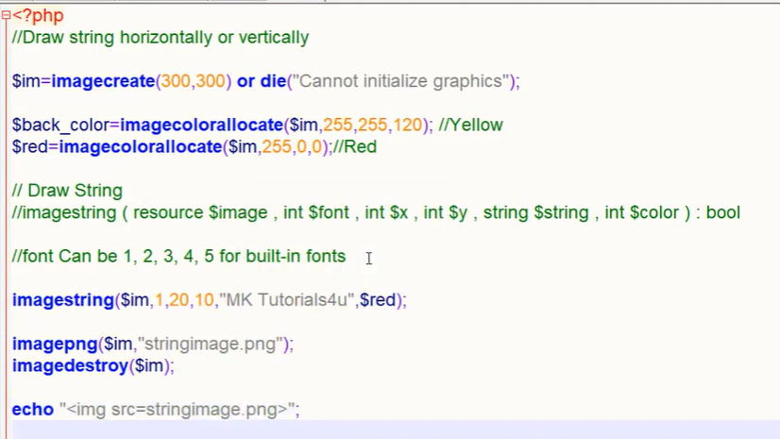
Example : Adding text to an image

Slide 26
<?php
$im = ImageCreate(300,300);
$black= ImageColorallocate($im,255,255,120);
$red = ImageColorAllocate($im,255,0,0);
ImageString($im,5,50,160,"hello how are you",$red);
Header('Content-Type: image/png');
ImagePNG($im);
?>

Slide 27
Create a new PHP script for drawing an arc:
<?php
// Create a blank image with a white background
$width = 400;
$height = 400;
$image = imagecreatetruecolor($width, $height);
$bgColor = imagecolorallocate($image, 255, 255, 255);
imagefill($image, 0, 0, $bgColor);
// Define the arc color (e.g., red)
$arcColor = imagecolorallocate($image, 255, 0, 0);
// Draw an arc
$startAngle = 45; // Starting angle in degrees
$endAngle = 135; // Ending angle in degrees
$x = $width / 2; // X-coordinate of the arc's center
$y = $height / 2; // Y-coordinate of the arc's center
$radiusX = 150; // X-axis radius
$radiusY = 100; // Y-axis radius
imagearc($image, $x, $y, $radiusX, $radiusY, $startAngle, $endAngle, $arcColor);
// Output the image to the browser
header("Content-type: image/png");
imagepng($image);
// Clean up resources
imagedestroy($image);
?>

Slide 28
To create a polygon in graphics using PHP
<?php
// Create a blank image
$width = 400;
$height = 400;
$image = imagecreatetruecolor($width, $height);
// Define colors
$white = imagecolorallocate($image, 255, 255, 255);
$red = imagecolorallocate($image, 255, 0, 0);
// Fill the background with white
imagefill($image, 0, 0, $white);
// Define polygon points
$points = array(
200, 50, // Point 1 (x, y)
250, 100, // Point 2
300, 100, // Point 3
350, 50, // Point 4
300, 0 // Point 5
);
// Draw the polygon
imagepolygon($image, $points, count($points) / 2, $red);
// Output the image to the browser
header("Content-type: image/png");
imagepng($image);
// Clean up resources
imagedestroy($image);
?>

Slide 29
To create an ellipse in graphics using PHP
<?php
// Create a blank image
$width = 400;
$height = 400;
$image = imagecreatetruecolor($width, $height);
// Define colors
$white = imagecolorallocate($image, 255, 255, 255);
$blue = imagecolorallocate($image, 0, 0, 255);
// Fill the background with white
imagefill($image, 0, 0, $white);
// Define ellipse properties
$x = $width / 2; // X-coordinate of the ellipse's center
$y = $height / 2; // Y-coordinate of the ellipse's center
$widthEllipse = 200; // Width of the ellipse
$heightEllipse = 100; // Height of the ellipse
// Draw the ellipse
imageellipse($image, $x, $y, $widthEllipse, $heightEllipse, $blue);
// Output the image to the browser
header("Content-type: image/png");
imagepng($image);
// Clean up resources
imagedestroy($image);
?>

Slide 30
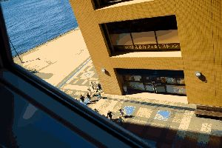
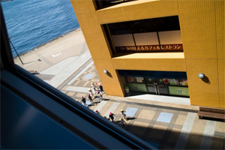
Imagecreate()
Imagecreatetruecolor()

